Slide 1



Sanskrit Sentence Parsing
Decoding Structure And Semantics

Slide 2
Introduction to Sanskrit Sentence Structure
रामः ग्रामम् द्विचक्रिकया गच्छति
Formula: W1 W2 W3 V
Explanation: Words can be deconstructed to root and suffix.

Slide 3
Word Breakdown
Diagram:
- W1 = R1 + S1
- W2 = R2 + S2
- W3 = R3 + S3
- V = R4 + VS
Key:
- R = Root word (Relates to real-world concept)
- S = Suffix (Indicates relation)
ग्राम अम्
द्विचक्रिका या
गम् ति
राम अः
Syntactic split

Slide 4
Understanding Suffixes
Core question: Do all suffixes mark relation or is just the VS sufficient?
- Key Aspects to Consider:
- Where is Information coded
- What is being coded
- Amount of information coded

Slide 5
Paninan Model of Representation:
Semantic Level
Karaka Level
Vibhakti Level
Surface Level

Slide 6
Karaka vs Vibhakti Level
Explanation:
- Karaka: Captures semantics closely related to the semantic level.
- Vibhakti: Purely syntactic.
Relevance: Karaka helps in parsing
Vibhakti provides syntactic structure.

Slide 7
Astadhyai's Role
Description: Astadhyai offers a mapping between the Karaka and Vibhakti levels.
Utility: Use this mapping to trace relationships and derive karaka information.

Slide 8
Example: Voice Variations in Sentences
Active Voice: "रामः वनम् गच्छति" (Rāmaḥ vanam gacchati) which translates to "Rama goes to the forest."
Passive Voice: "वनं रामेण गम्यते" (Vanam rāmeṇa gamyate) which translates to "The forest is gone to by Rama."
Key Takeaway: Regardless of the voice, the key elements (Rama and the forest) and the action (going) remain the same. The 'Karaka' relations in Sanskrit grammar ensure that the underlying semantic structure remains consistent across different syntactic presentations.

Slide 9
Designing a Parser
1. Identify grammar & morphological meaning of each word from the dictionary. Find local word groupings.
2. Identify Vibhakti markers and determine the verb’s tense, aspect, and modality.
3. Use the core parser to identify Karaka relations based on the verb's Karaka frame and transformation rules.
Note: Each noun group is tested against Karaka restrictions in the Karaka frame of the verb.

Slide 10
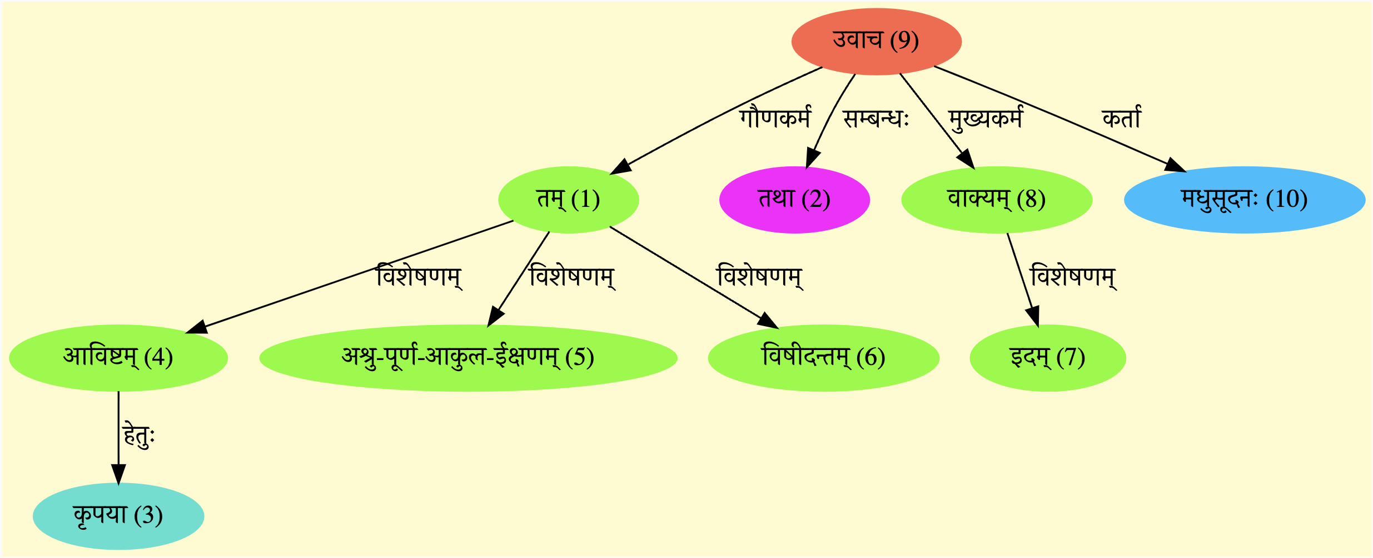
Parsing Output Overview
Visualization: https://sanskrit.uohyd.ac.in/sbg-ereader/#/ereader
Key Insight: The Graph demonstrates the relationships and structure within the sentence.

Slide 11
Conclusion
Importance of understanding sentence structure in Sanskrit for effective parsing.
Value of the Paninan model and Astadhyai's mapping.
The potential for further exploration and research in this domain.

